Slide 1

Working with files
Marian Cornea

Slide 2
File system
A file system is used to control how data is stored and retrieved
By separating the data into pieces and giving each piece a name, the information is easily isolated and identified.
Taking its name from the way paper-based information systems are named, each group of data is called a file
A directory is a file system cataloging structure which contains references to other computer files, and possibly other directories.

Slide 3
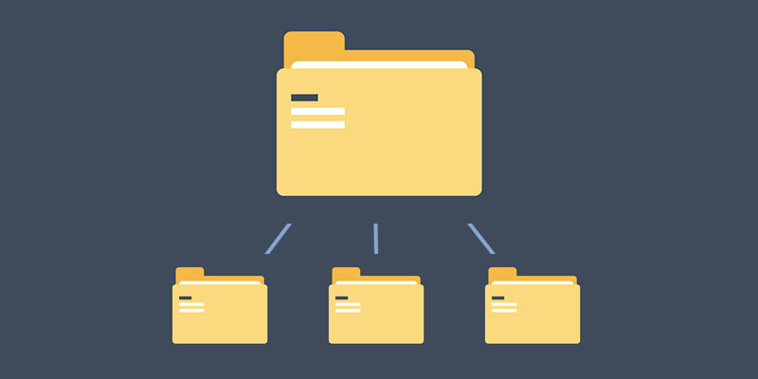

Slide 4
Path
A path, the general form of the name of a file or directory, specifies a unique location in a file system
File: "C:\dir1\file1.txt“
Directory: "C:\dir2“
An absolute or full path points to the same location in a file system, regardless of the current working directory
A relative path starts from some given working directory, avoiding the need to provide the full absolute path

Slide 5
Relative paths
Directory separator \
Current directory .
Parent directory ..

Slide 6
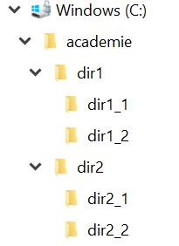
DEMO
Create the folder structure
Go to dir1_1 using windows explorer
Holding “shift” right click in the empty folder
Choose “Open command window here”
Use “CD” to go through all the folders
Using one “CD” command go from:
dir1 => dir2
dir2 => dir1_1
dir1_1 => dir2_2

Slide 7
Reading files
int lineCounter = 0;
var file = new StreamReader(sampleFilePath);
while (true) {
var line = file.ReadLine();
if (line == null) break;
Console.WriteLine(line);
lineCounter++;
}
file.Close();
Console.WriteLine("There were {0} lines.", lineCounter);

Slide 8
Reading files
using (StreamReader sr = new StreamReader(sampleFile2)) {
String line = sr.ReadToEnd();
Console.WriteLine(line);
}
Read a one line file
Read a file with more line
What is displayed? Why?

Slide 9
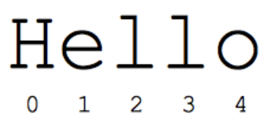
String
represents a sequence of zero or more Unicode characters
the [] operator can be used for readonly access to individual characters

Slide 10
Demo
var textSample1 = "there is no finish line!";
var textSample2 = "\there is no finish line!";
Console.WriteLine(textSample1);
Console.WriteLine(textSample2);
Console.WriteLine(textSample1[0]);
Console.WriteLine(textSample1[1]);
Console.WriteLine(textSample2[0]);
Console.WriteLine(textSample2[1]);

Slide 11
Reading files
string text = System.IO.File.ReadAllText(sampleFile);
Console.WriteLine("Contents of sampleFile = {0}", text);
Console.WriteLine();
string[] lines = System.IO.File.ReadAllLines(sampleFile);
Console.WriteLine("Contents of sampleFile = ");
foreach (string line in lines){
Console.WriteLine(line);
}

Slide 12
Exercises
A program to display the last 3 lines of a file
A program to display the longest 4 words from a file
A program to count the number of words in a file
A program to count the frequency of words in a file

Slide 13
Writing files
string[] lines = { "First line", "Second line", "Third line" };
using (StreamWriter outputFile = new StreamWriter(sampleFile3)){
foreach (string line in lines)
outputFile.WriteLine(line);
}

Slide 14
Appending files
using (StreamWriter outputFile = new StreamWriter(sampleFile3, true))
{
outputFile.WriteLine("Fourth Line");
}

Slide 15
Writing files
string[] lines = { "First line", "Second line", "Third line" };
using (StreamWriter outputFile = new StreamWriter(sampleFile4))
{
outputFile.Write(string.Join("\n",lines));
}

Slide 16
Writing files
string text = "First line" + Environment.NewLine;
text += "Second line" + Environment.NewLine;
text += "Third line" + Environment.NewLine;
File.WriteAllText(sampleFile5, text);
string[] lines = { "Forth line", "Fifth line" };
File.AppendAllLines(sampleFile5, lines);

Slide 17
Exercises
A program to copy the contents of a file to a new file, without the third row
A program to copy the contents of a file and add it to the end of a second file
A program to merge the contents of two files and write the result in a new file (one line from each file)
A program to remove the new line characters from a file
A program to replaces tabs with four space characters in a file

Slide 18


